Slide 1
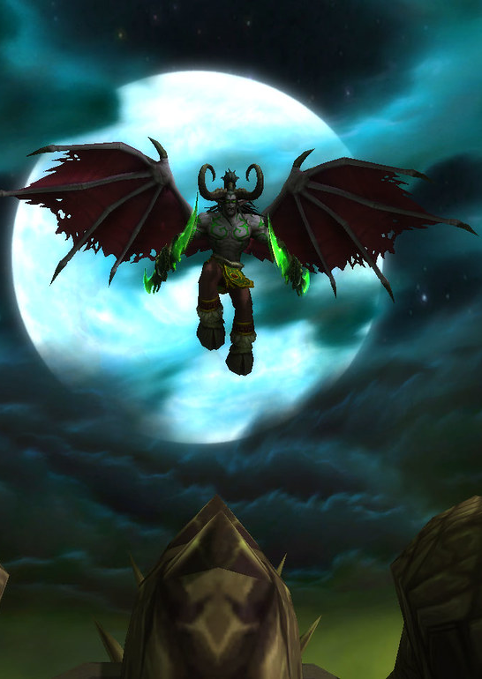
World of Warcraft: Warlock vs. Paladin Who Rules the Battlegrounds?
Matthew Collins
Dsc530 – exploratory Data Analysis

Slide 2
“Time's up, let's do this!”
- Leeroy Jenkins (WOW Legend)

Slide 3
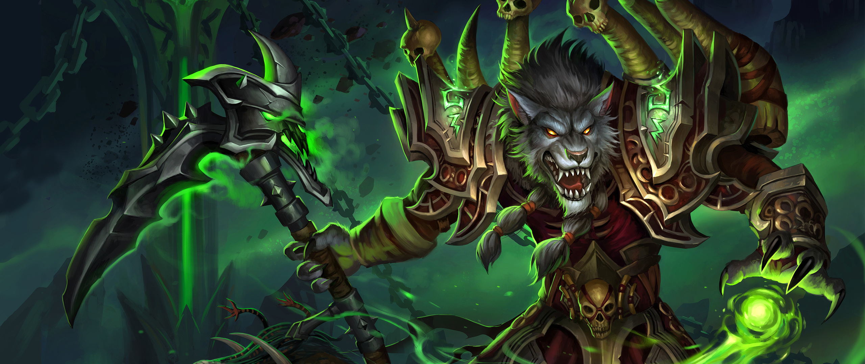
Hmmm Questions and more Questions
HO: Warlocks and Paladins perform the same in battlegrounds
H1: Warlocks are better than Paladins in battlegrounds
HO2: The amount of damage and healing a warlock does are not related.
H2: The amount of damage can be predicted by the amount of healing a warlock does.

Slide 4
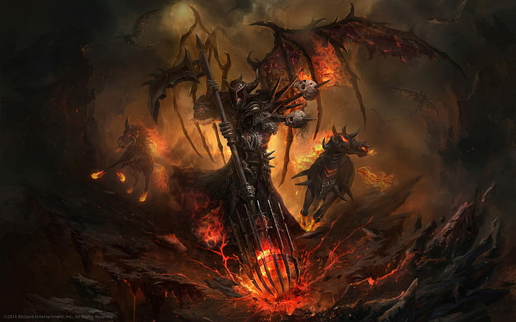
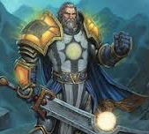
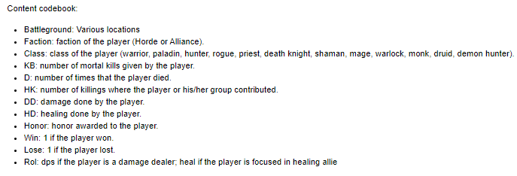
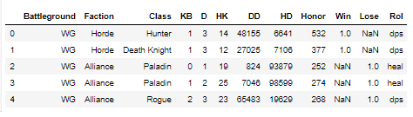
Do I play a Warlock or Paladin?
Original Data Set:
https://www.kaggle.com/cblesa/world-of-warcraft-battlegrounds
Data Set Codebook (Describe the variables):

Slide 5

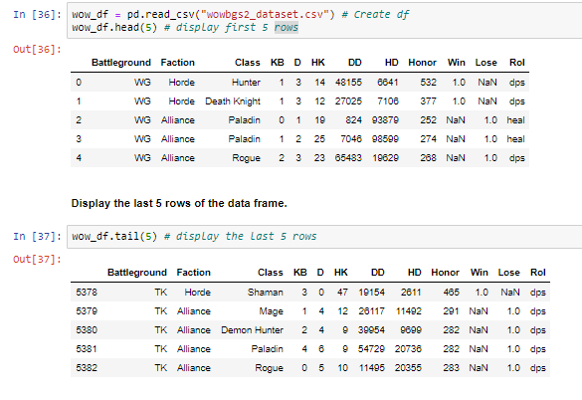
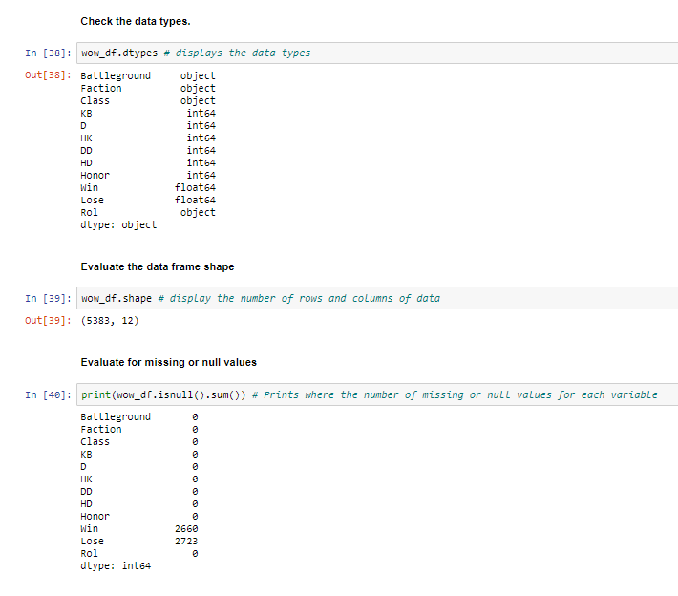
We did it all for the Data!
Check Data Head & Tail of the Data Set
Outline the Data Type and Nulls

Slide 6
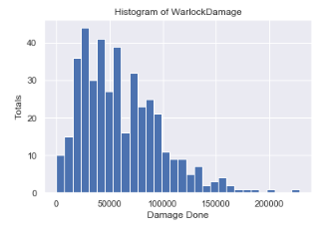
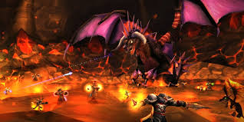
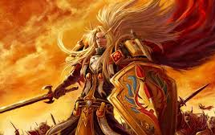
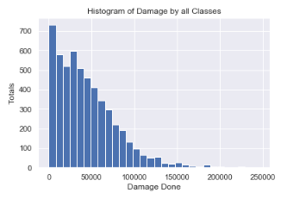
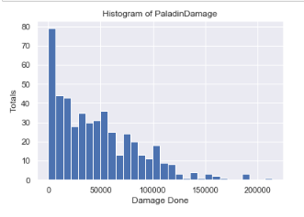

The Histogram of Damage never Lies!?!

Slide 7
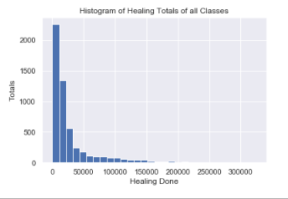
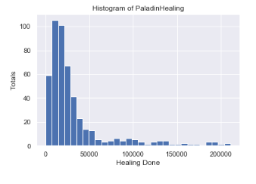

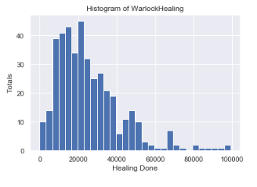


How about the Histogram of Healing Done!?!

Slide 8
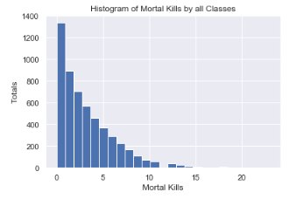
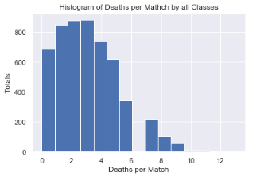
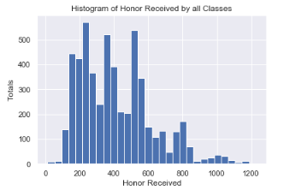

Histograms both fun and variable!
Why not look at some other cool variables from the data set: Mortal Kills, Deaths, Honor Gained!

Slide 9
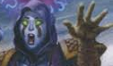
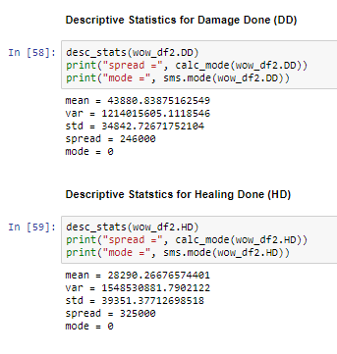
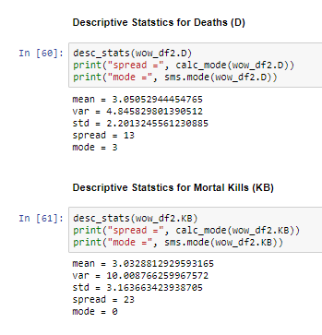
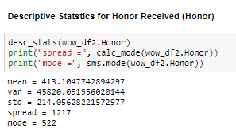
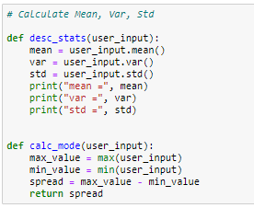
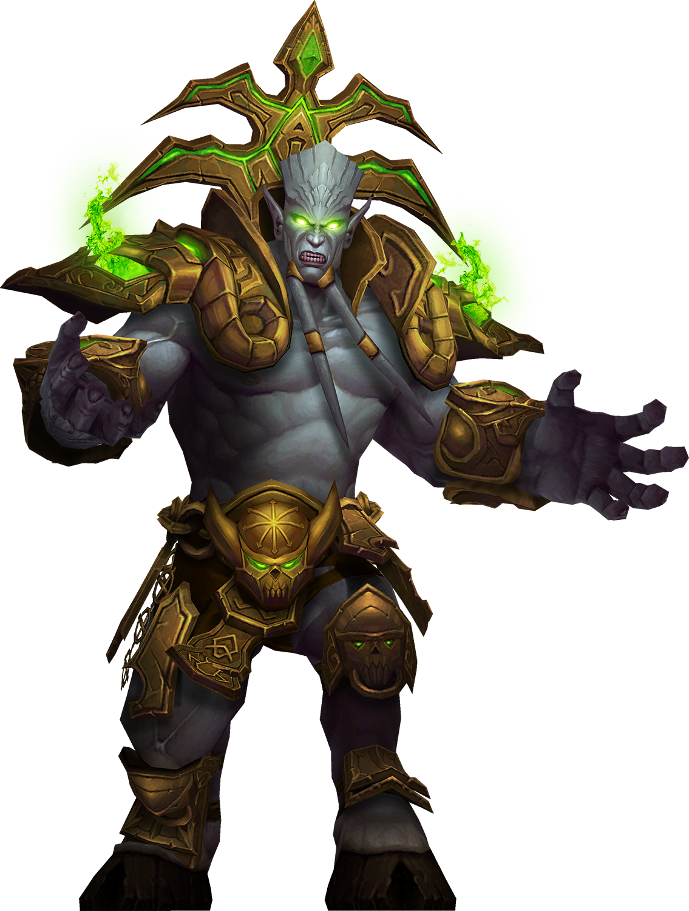
What is Data without Descriptive Statistics? (Think a party without Beer!!!)
Looky, looky.. A Function

Slide 10
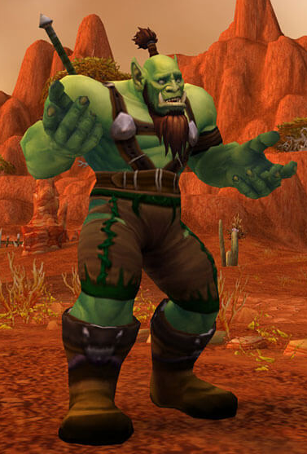
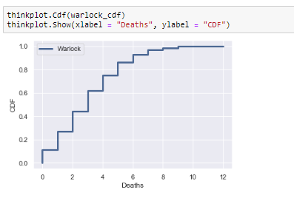
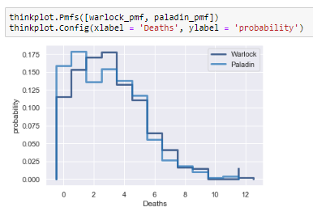
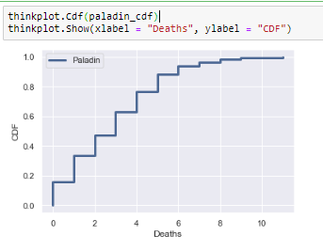
Time to compare the Warlock Superiority vs. the Paladin (no inherent bias in my statement)
Paladins have to die more than Warlocks!?!
How about a look using PMF and CDF

Slide 11
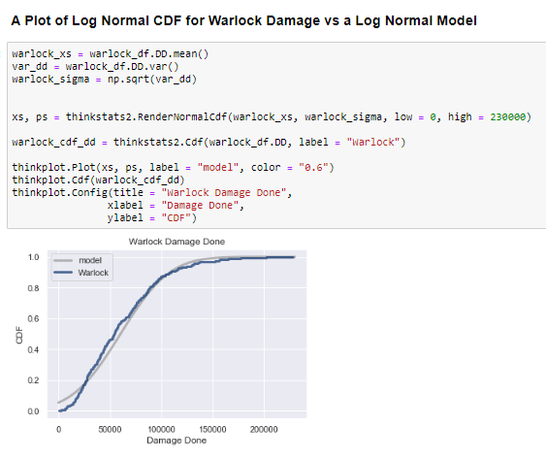
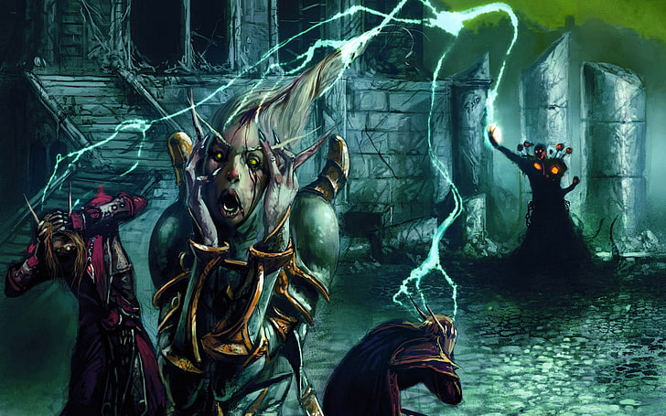
Oh you didn’t know? Log Normal CDF for the Warlock Win!

Slide 12
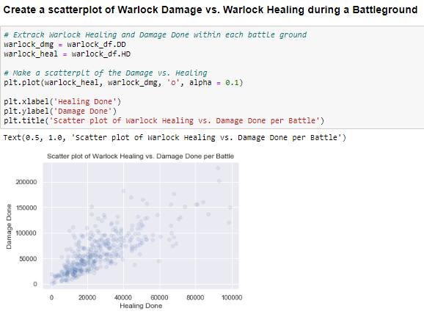
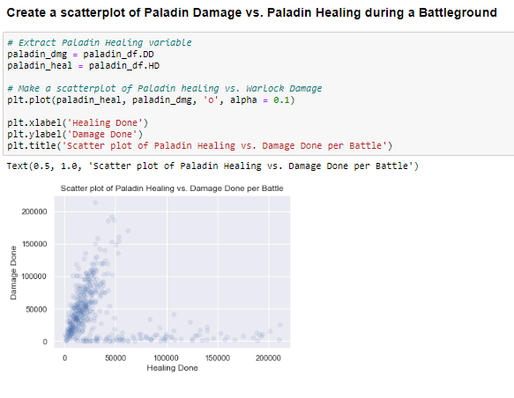
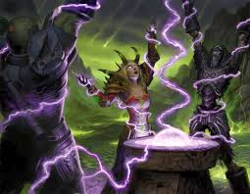

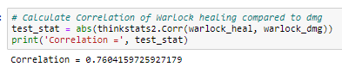
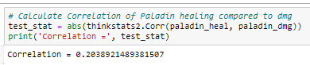
Let the Reign of Confusion Begin! Scatterplots for clarity

Slide 13
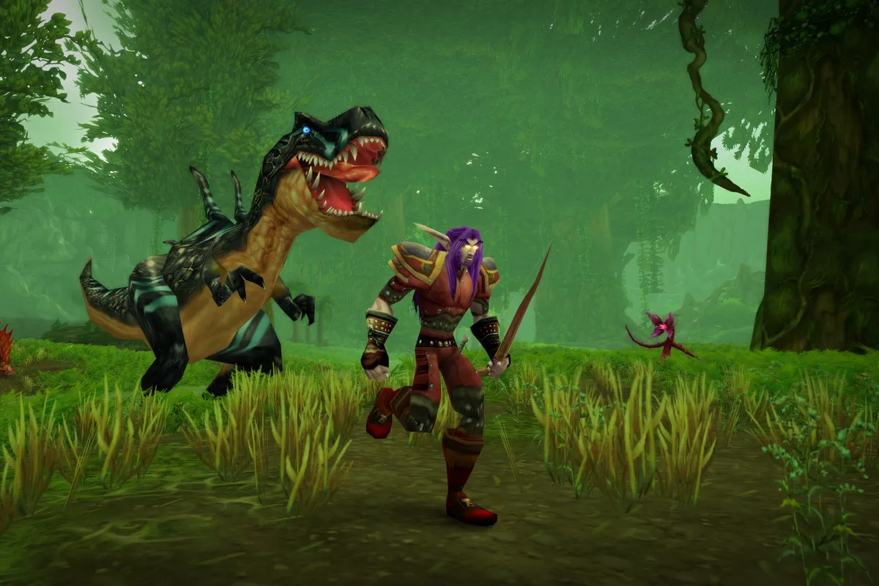
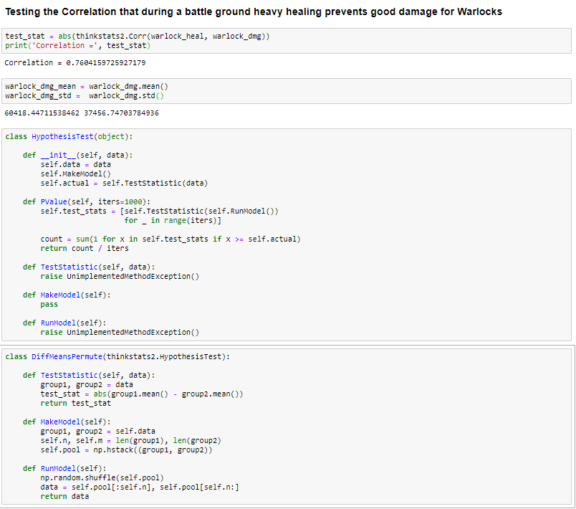
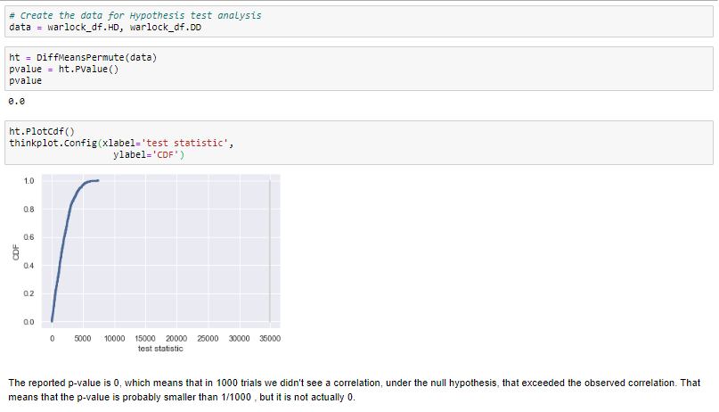
How about a Dash of Hypothesis Testing?

Slide 14
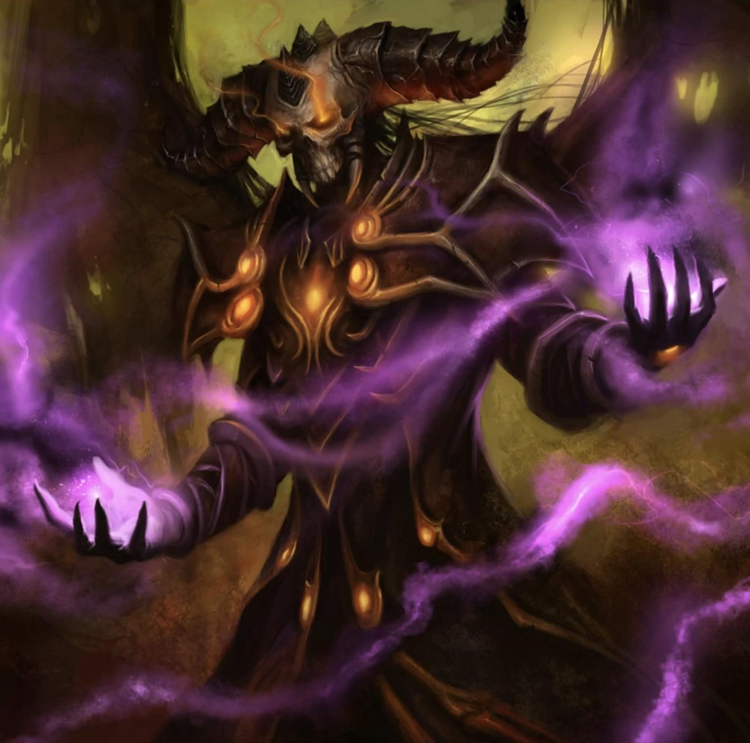
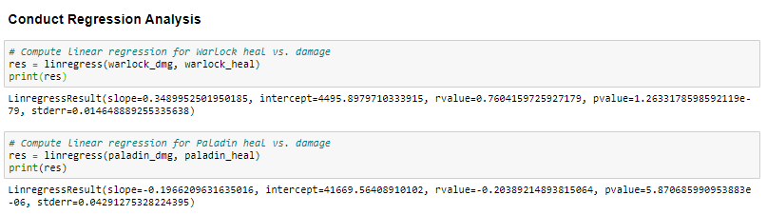

Who does not love regression analysis!?!
Significance is apparent with the reported p-value.
Warlock has positive slope with more healing more damage.
Paladin has negative slope with more healing less damage.
Are my damage and healing linked?

Slide 15
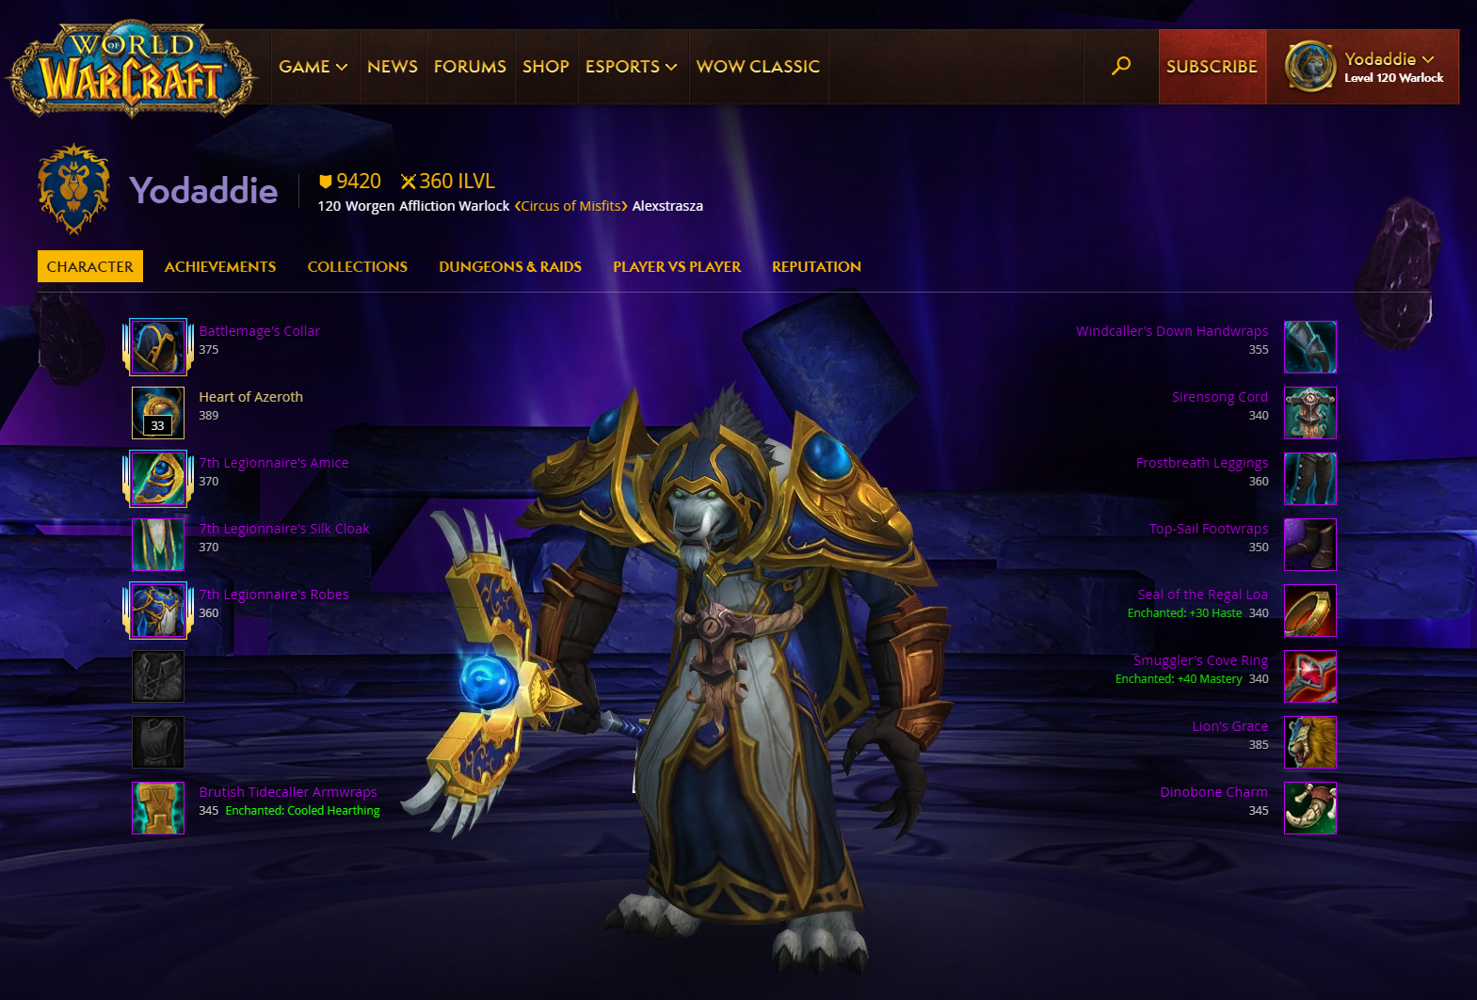
Special Thanks To:
Like all great stories….. This one has come to…..THE END
Prof Metzger keeping me focused
All the members of the Slack community for helping me overcome numerous obstacles
Kaggle for providing access to the data
World of Warcraft for making me waste hours of my life

